Slide 1
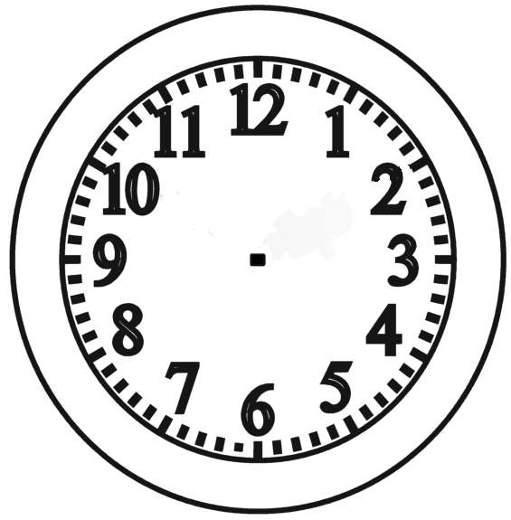
Task Plan
What do I need? 1 ………………………… 4 …………………………..
2 ………………………… 5 …………………………..
3 ………………………… 6 …………………………..
What do I need to do?
………………………………………………………………………………………… ☐
………………………………………………………………………………………… ☐
………………………………………………………………………………………… ☐
What do I do next?
………………………………………………………………………………………… ☐
………………………………………………………………………………………… ☐
Reward
Start
Finish

