Slide 1


Welcome to Year 2

Slide 2

Meet the Team
Miss Macdougall
Mrs Helen Webb

Slide 3

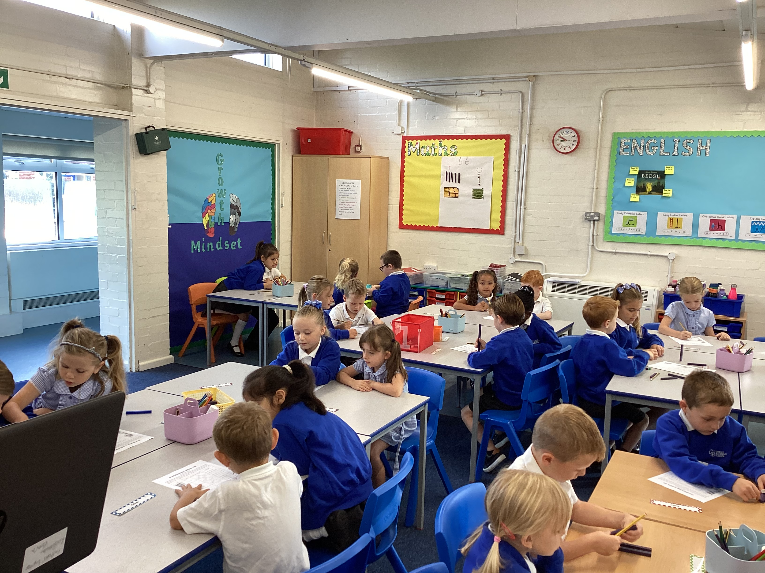
A Typical Day in Year 2
08:40- Children arrive-Morning Work
08:55- Register
09:15- English
09:55- Phonics/Spelling
10:25- Assembly
10:40- Break
11:00-Maths
12:00- Lunch
1:00-Register
1:05- Foundation Subjects (PE Tuesday and Friday)
3:00- Story

Slide 4
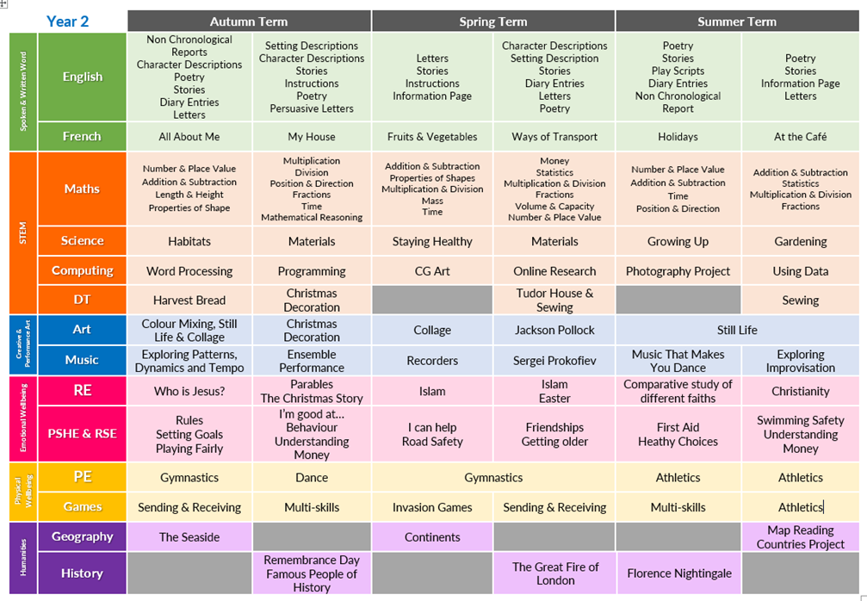
Curriculum

Slide 5
Home Learning
10 min reading a night. Noted in reading record
(not just school reading book!)
Home Learning set on Friday via tapestry. It will note learning for the following week so you can have discussions at home or there may be learning that children can share with you.
Send in special comments/ pictures on tapestry and I will comment/like the post but this won’t be daily.
As the term progresses I will set spellings for a weekly test on a Friday.
Once we have covered Multiplication and Division in Maths I will set Times Table Rockstar up with log ins.

Slide 6

Things to remember......
Homework days- Friday
PE- Tuesday and Friday Library- Thursday
Change books-Monday and Thursday
Fruit or veg for snack
Pre select lunch choices
Check Tapestry

Slide 7
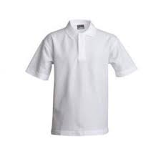
Uniform
Uniform
Blue checked dress
Grey shorts or trousers
White logo-ed polo shirt
Blue round-necked logo-ed sweatshirt or cardigan
White socks for girls
Grey or black socks for boys
Black shoes (sensible design, not slip ons nor trainers)
Winter
White logo-ed polo shirt
Grey skirt, pinafore or trousers
Blue round-necked logo-ed sweatshirt or cardigan
White socks or grey tights with skirts
Grey or black socks with trousers for boys
White socks can be worn by girls with trousers
Black shoes (sensible design, not boots nor trainers)
PE
Blue logo-ed t-shirt
Blue shorts
Trainers for outdoors (Plimsols for Infants during the winter)
Plain, dark jogging bottoms and sweatshirt may be worn outside when cold.

Slide 8
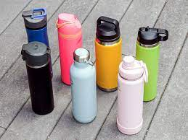
Equipment to remember...
PE Kit
Water bottle - water only
Reading book and record
Coat
All labelled

Slide 9
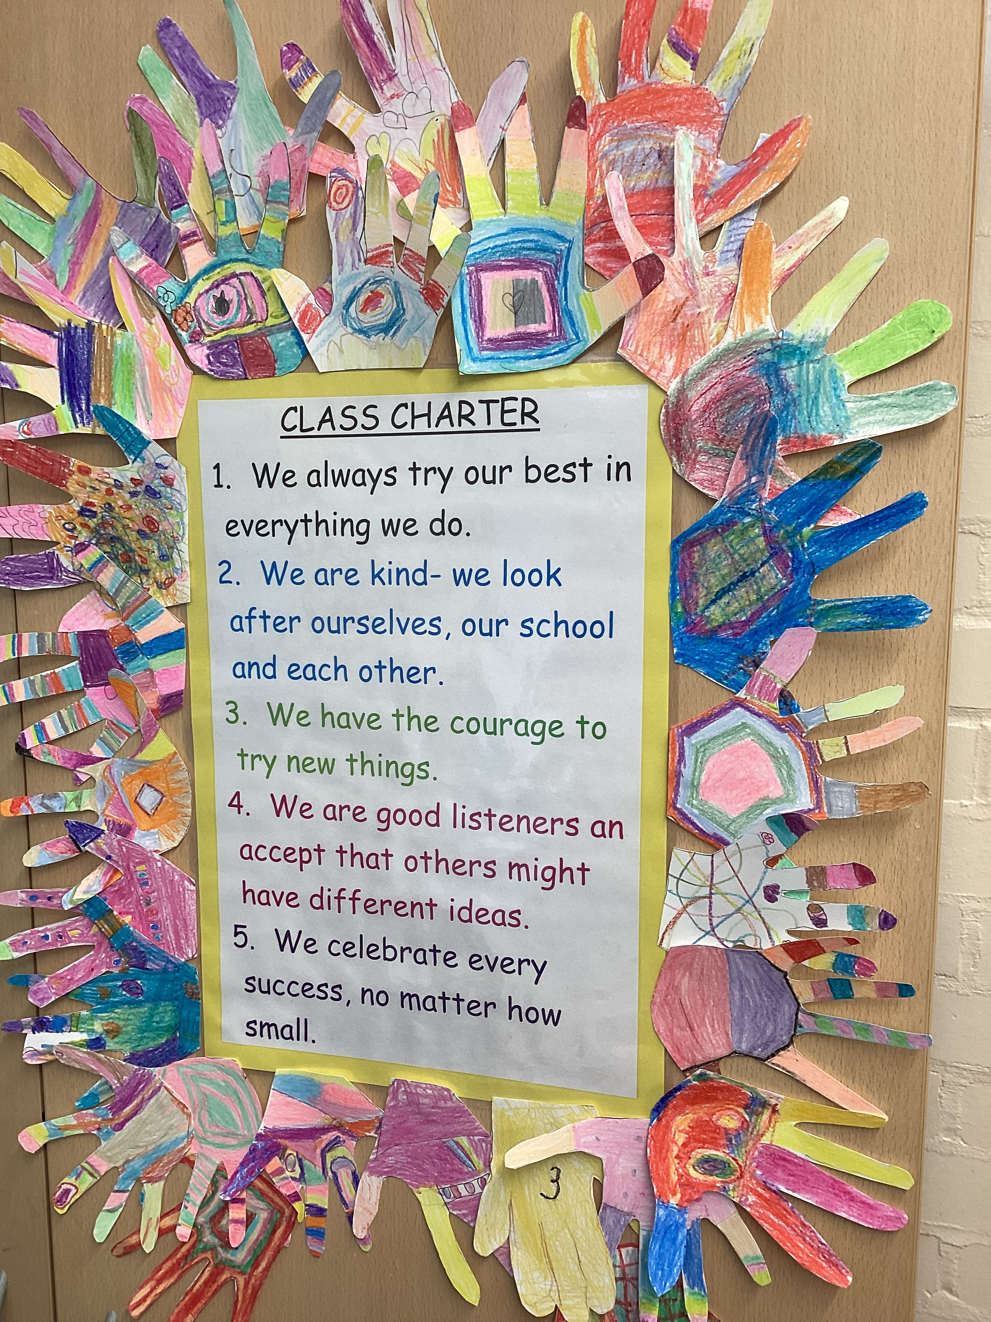
Class Charter
We always try our best in everything we do
We are kind – we look after ourselves, our school and each other
We have the courage to try new things
We are good listeners and accept that others may have different ideas
We celebrate every success, no matter how small

Slide 10

Rewards
Dojo Points
Praise
Stickers
Going to the front of the line
Choosing a story
Seeing Key Stage Lead/ Deputy Head/ Headteacher
Sanctions
Reminders
Move to focus spaces
2 min time out within class with sandtimer
Spoken to another senior member of staff

Slide 11
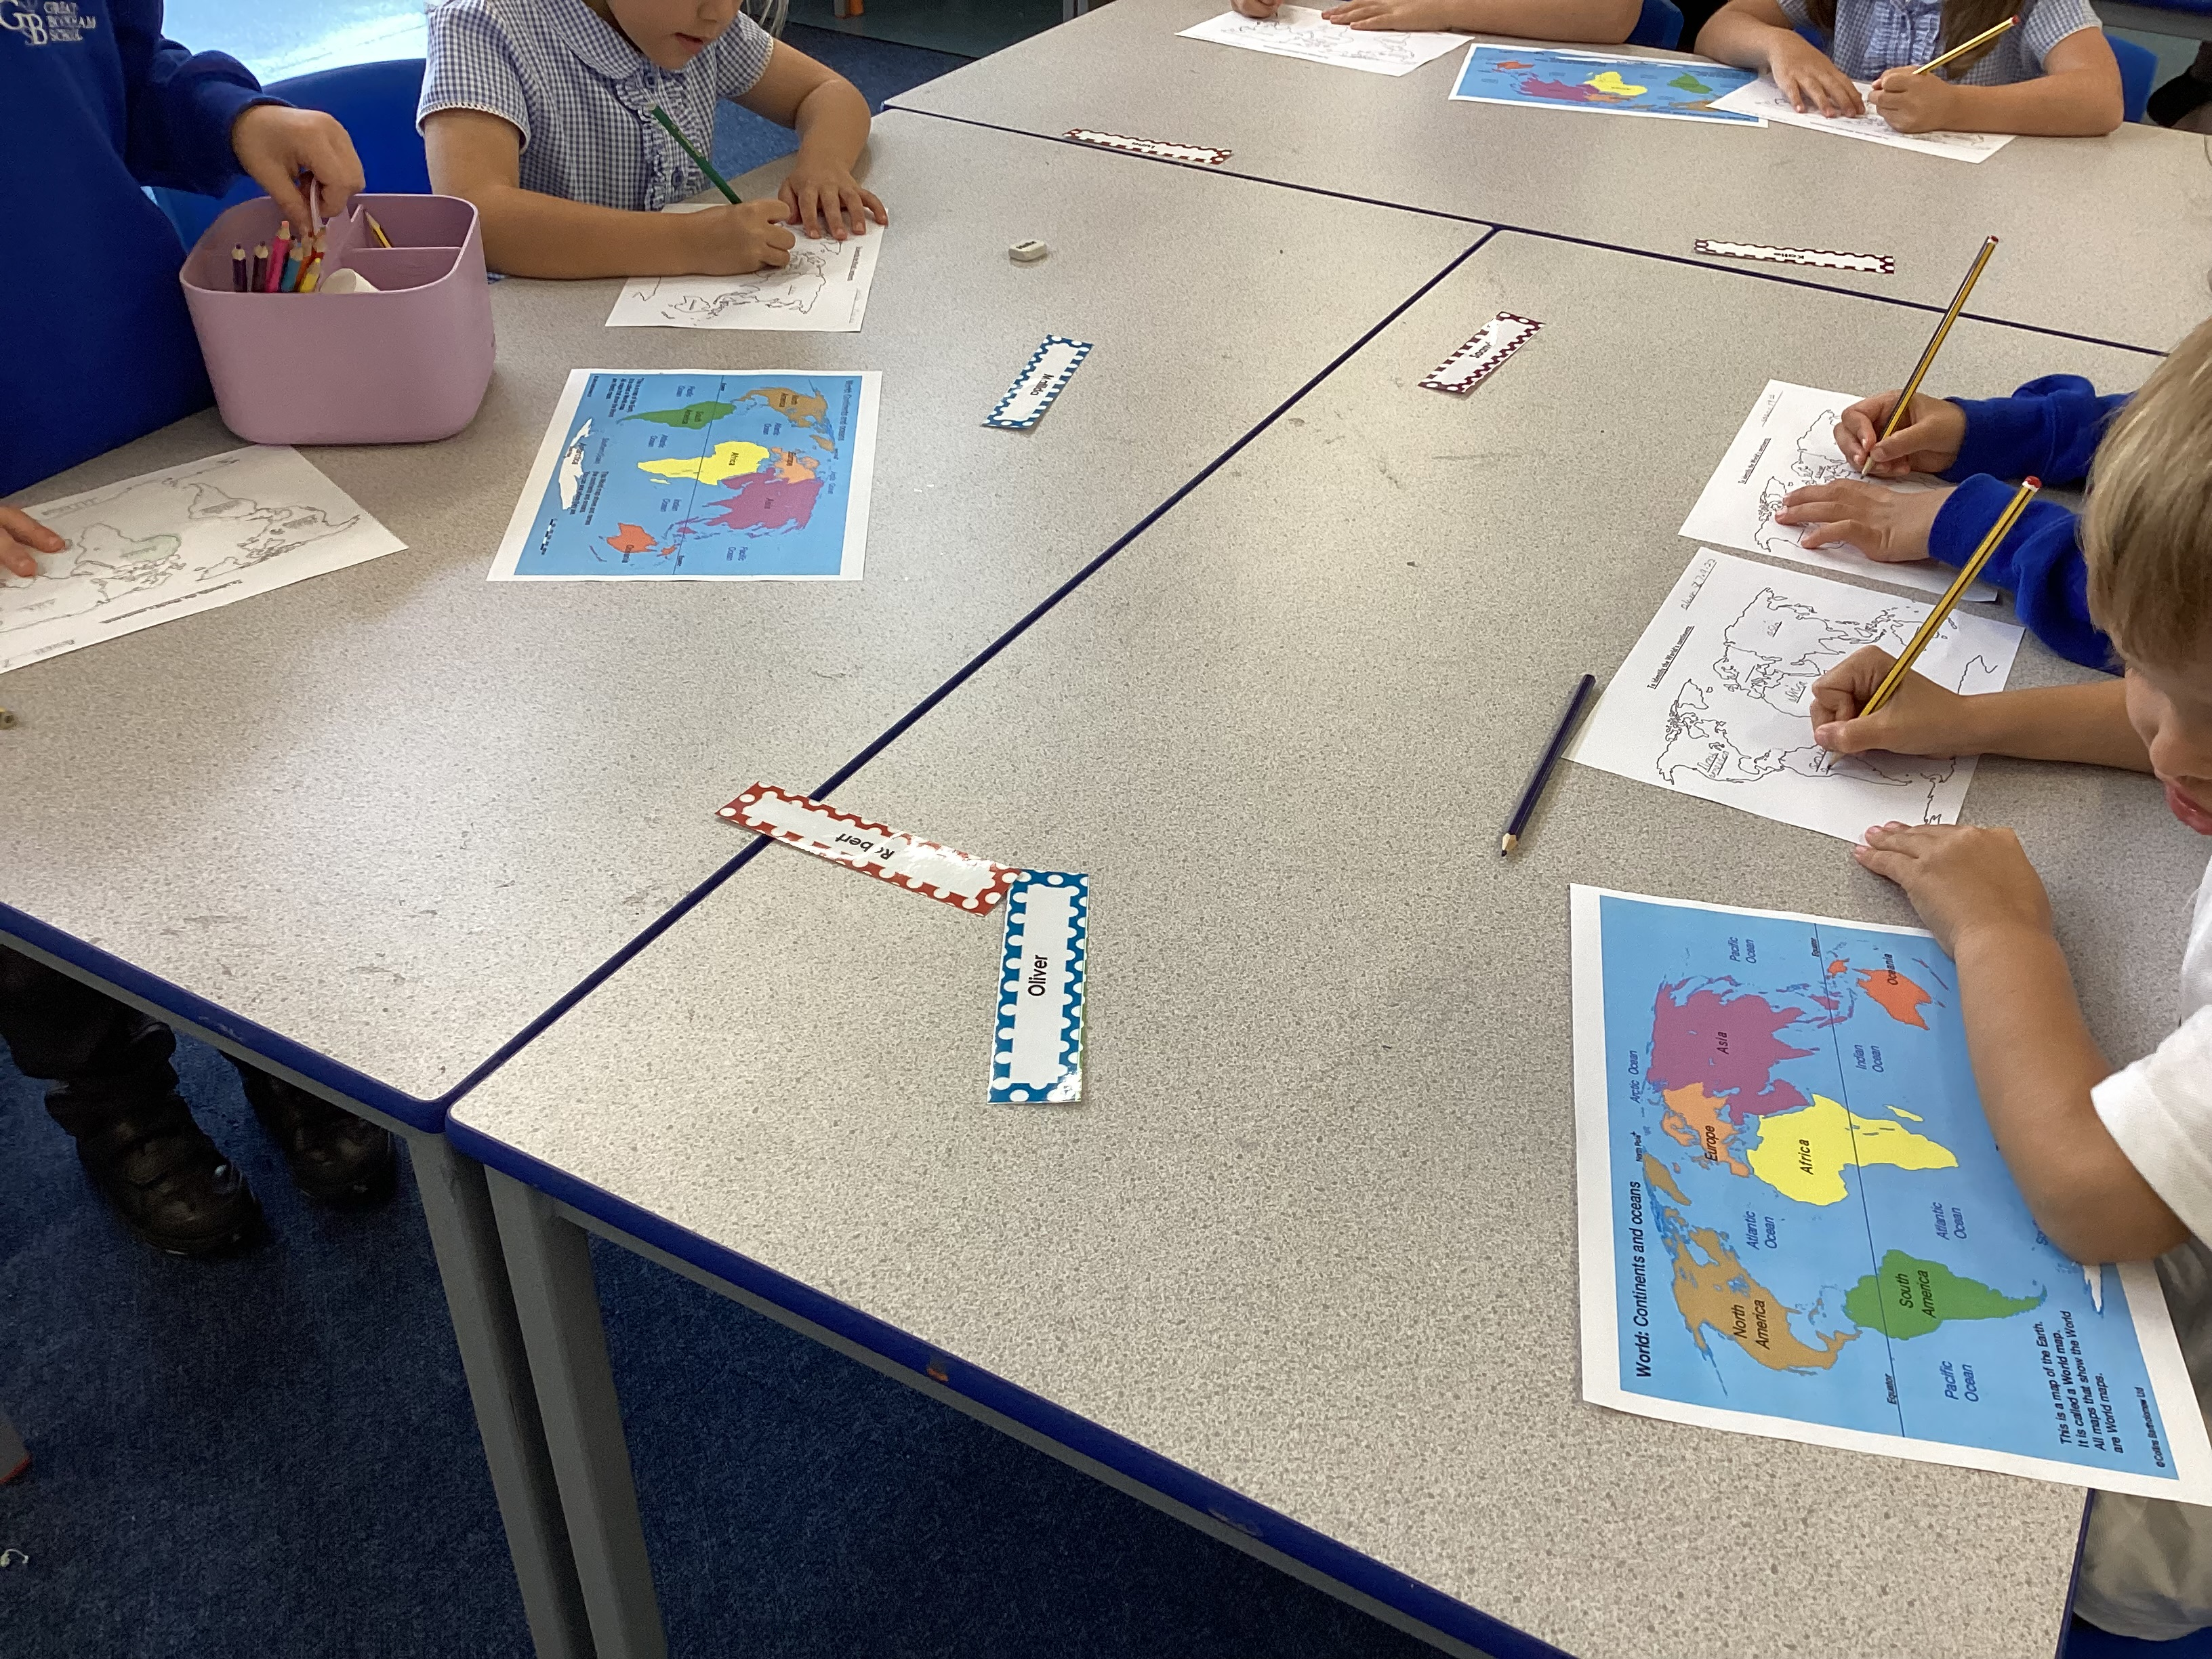
How you can support your child at home?
*Noting reading in reading record.
*Support in spelling, number bonds.
*Talk about school day- topics we are covering.
*Discuss Home Learning.
*Keep encouraging learning-positivity!

Slide 12

AOB

